Slide 1
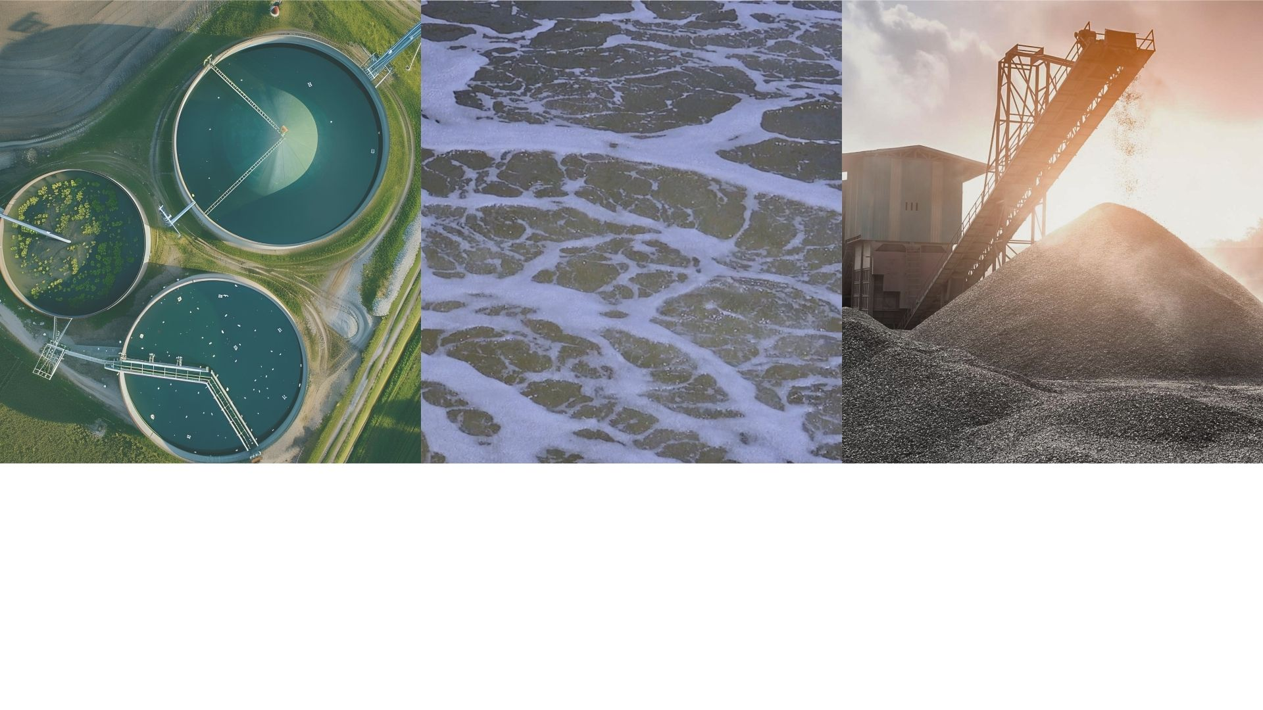

Moving What Matters
An Introduction to Atlantic Pumps

Slide 2
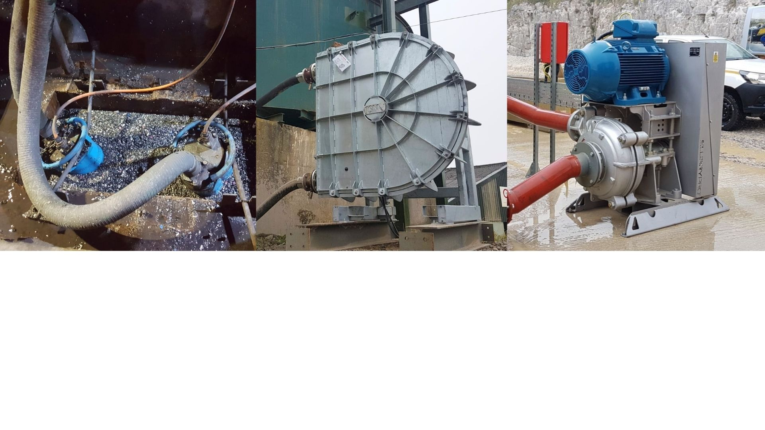
Our purpose is to be the most responsive pump company globally — delivering fast, reliable solutions when our customers need them most.

Slide 3
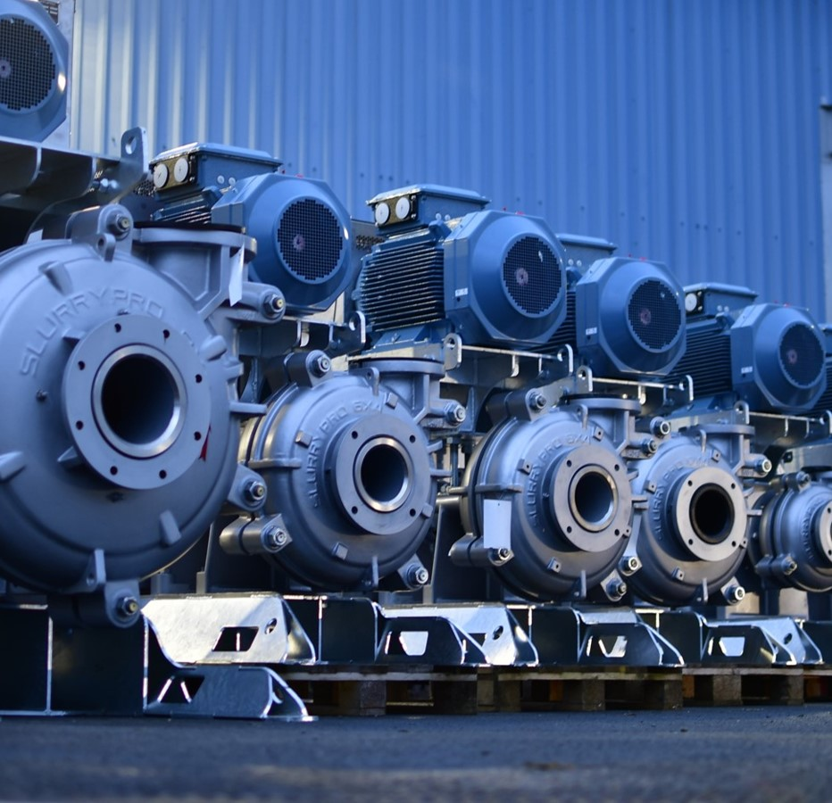

About Us
We move what matters, no matter what. We take the time to find out what really matters to you.
We provide the products and expertise to help you move water, sludge, slurries and digestate efficiently with a lower whole life cost.

Slide 4
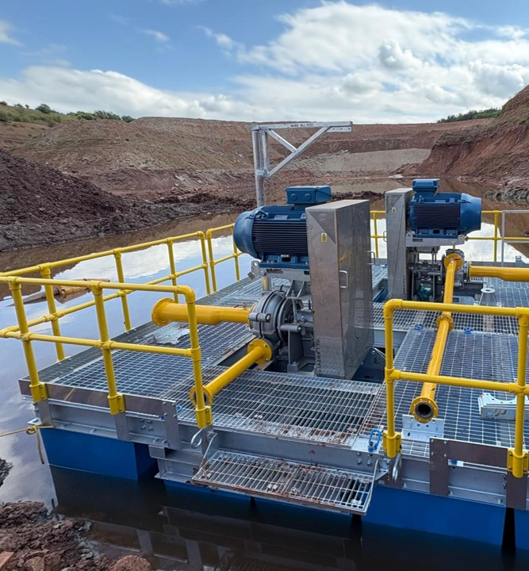

Delivering Value
By taking a clear-cut, customer first approach, we drive sustainability through solutions that are designed to meet stringent industry demands.
We take the time to understand what really matters to you.
We provide options to the end user to reduce operating costs by offering pumps that are robust and more reliable which in turn reduces your lifetime costs in spare parts and downtime.

Slide 5
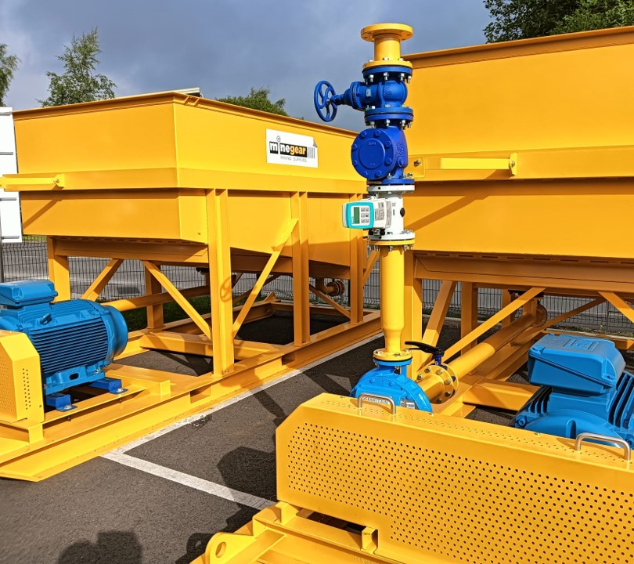
Our Unique
Approach
Understand your needs & requirements
Provide advice on TOTEX
Reduce downtime and operational efficiencies
Responsive

Slide 6
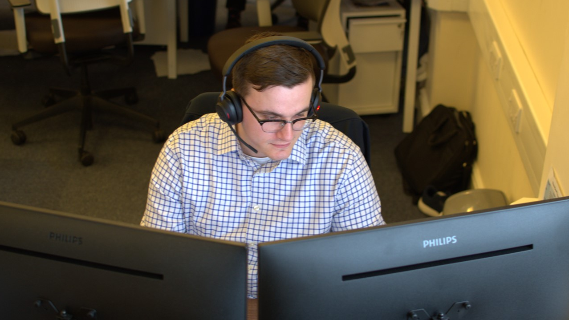
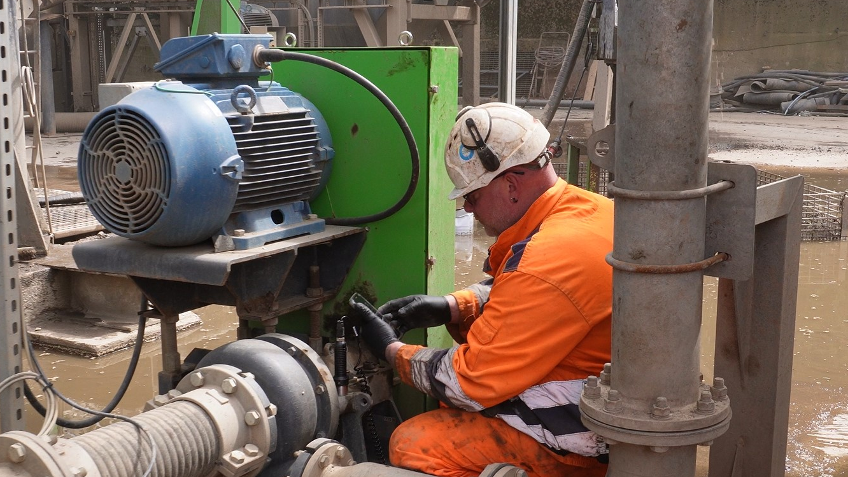
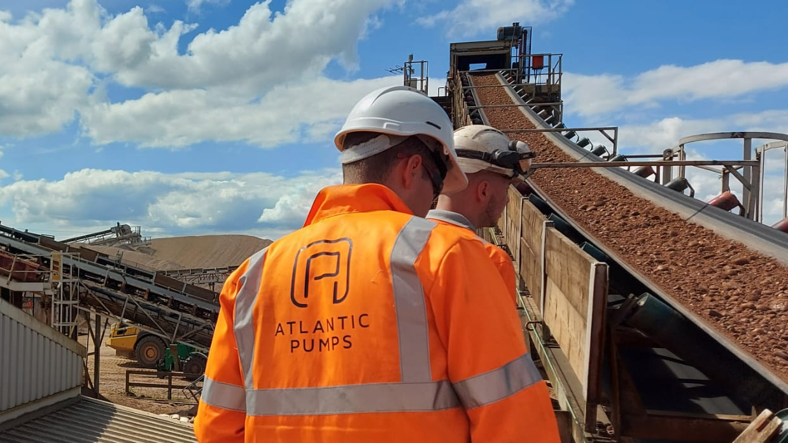
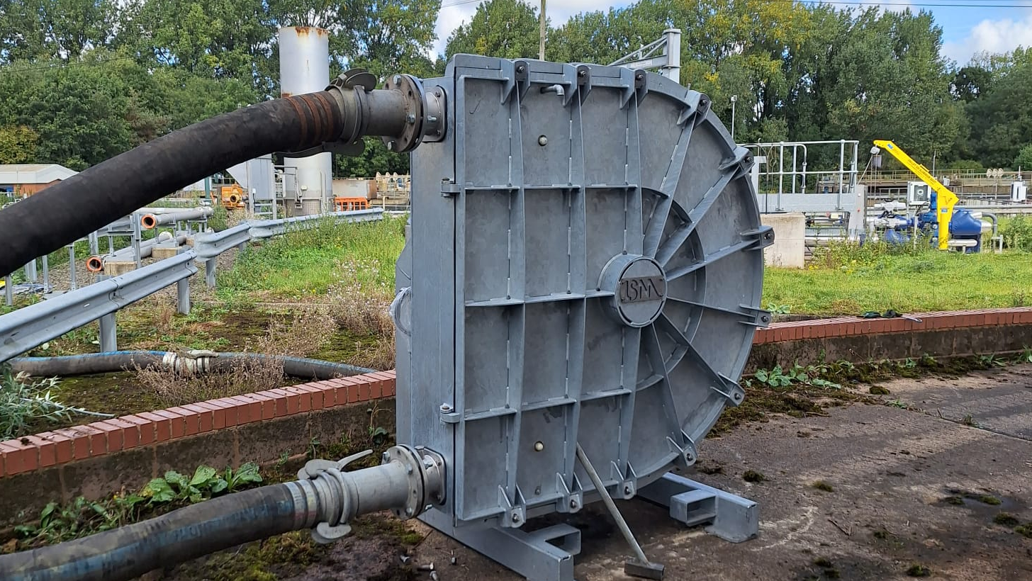
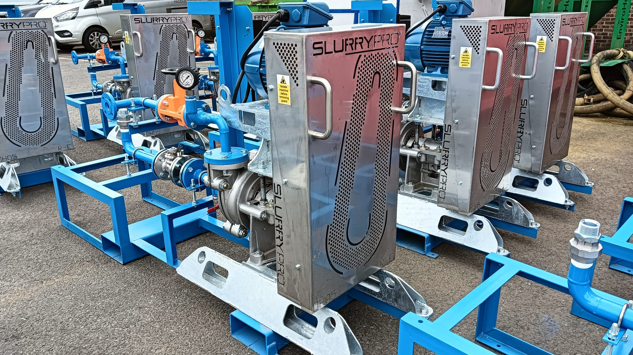
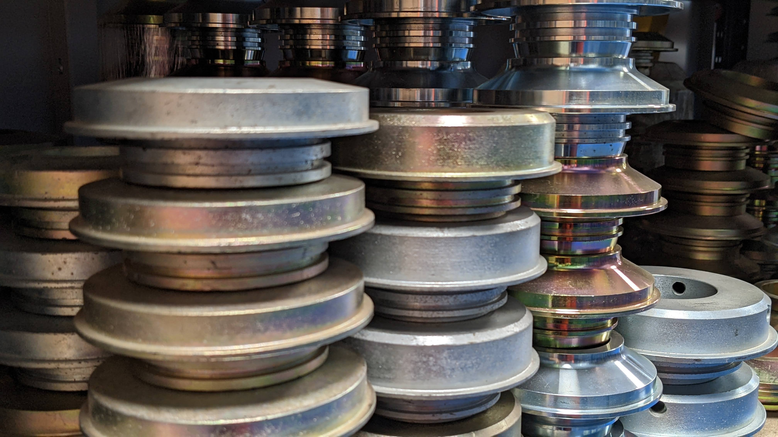
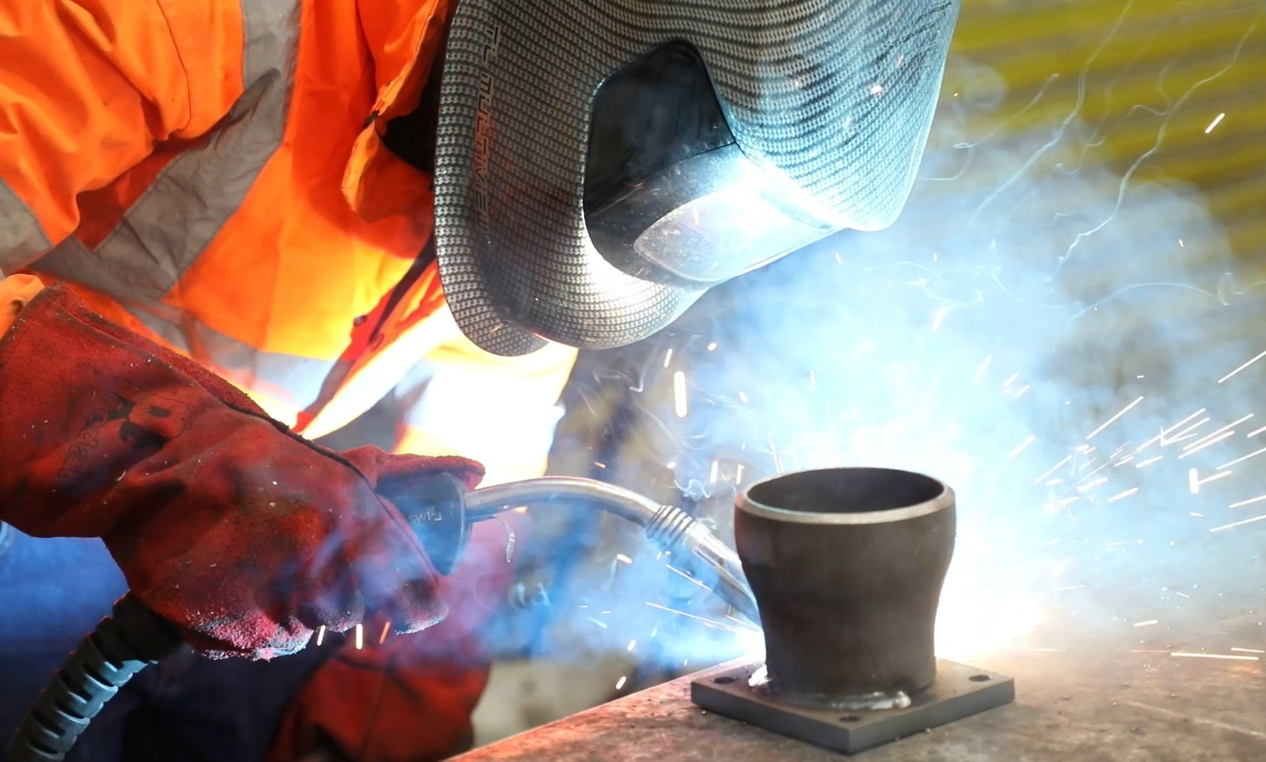
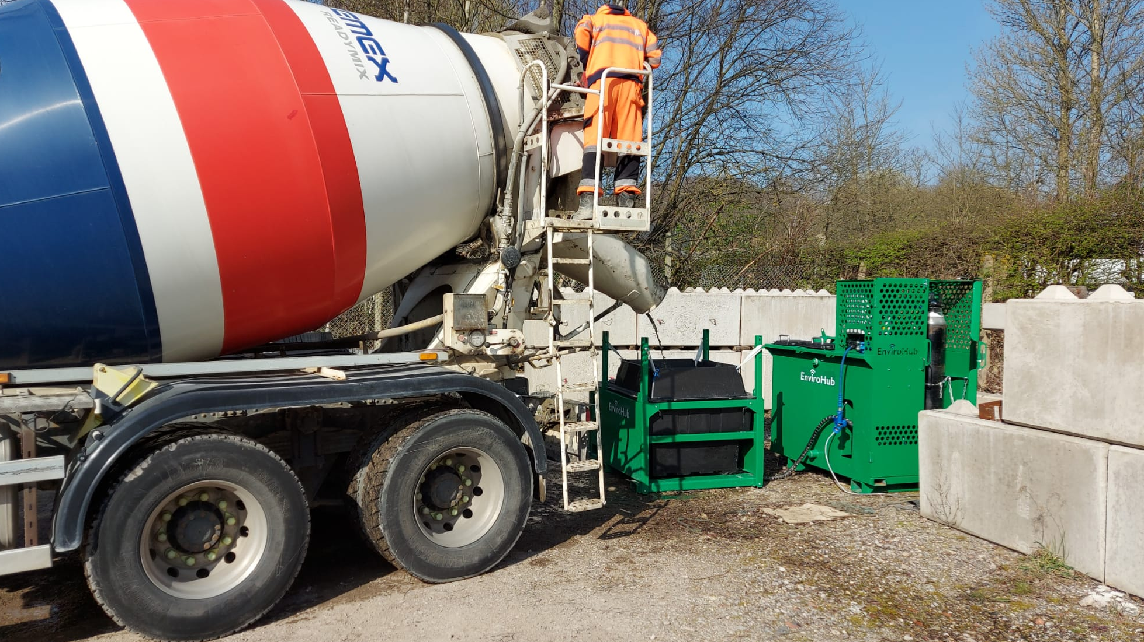
Tailored Solutions
Digital Monitoring

Slide 7
Onsite Servicing & Maintenance

Slide 8
Process Improvement & Optimisation

Slide 9
Pump Rental

Slide 10
Pumping Solutions

Slide 11
Pump Spares & Wear Parts

Slide 12
Repairs, Build & Refurbishments

Slide 13
Water Treatment & Monitoring

Slide 14
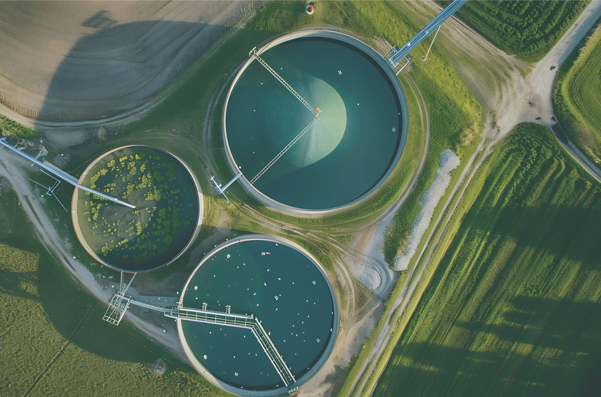





Trusted by…

Slide 15






Trusted by…

Slide 16
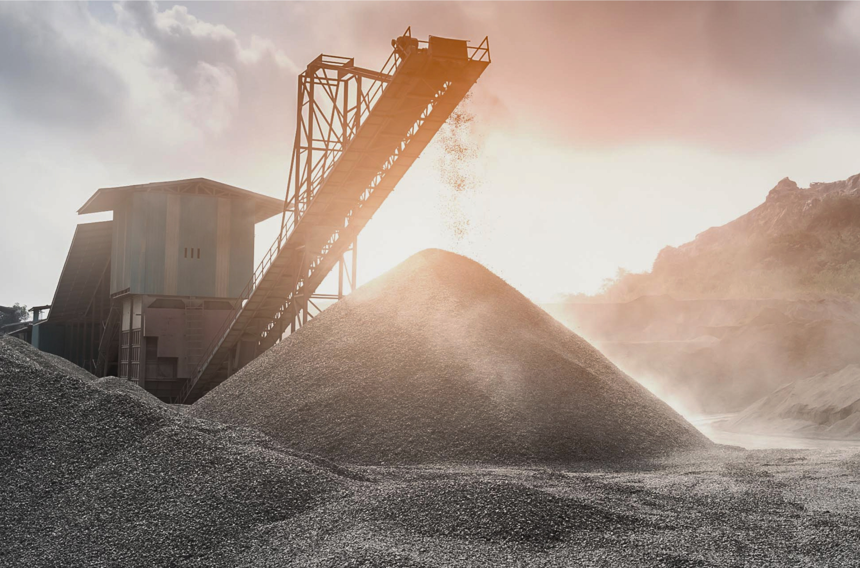





Trusted by…

Slide 17
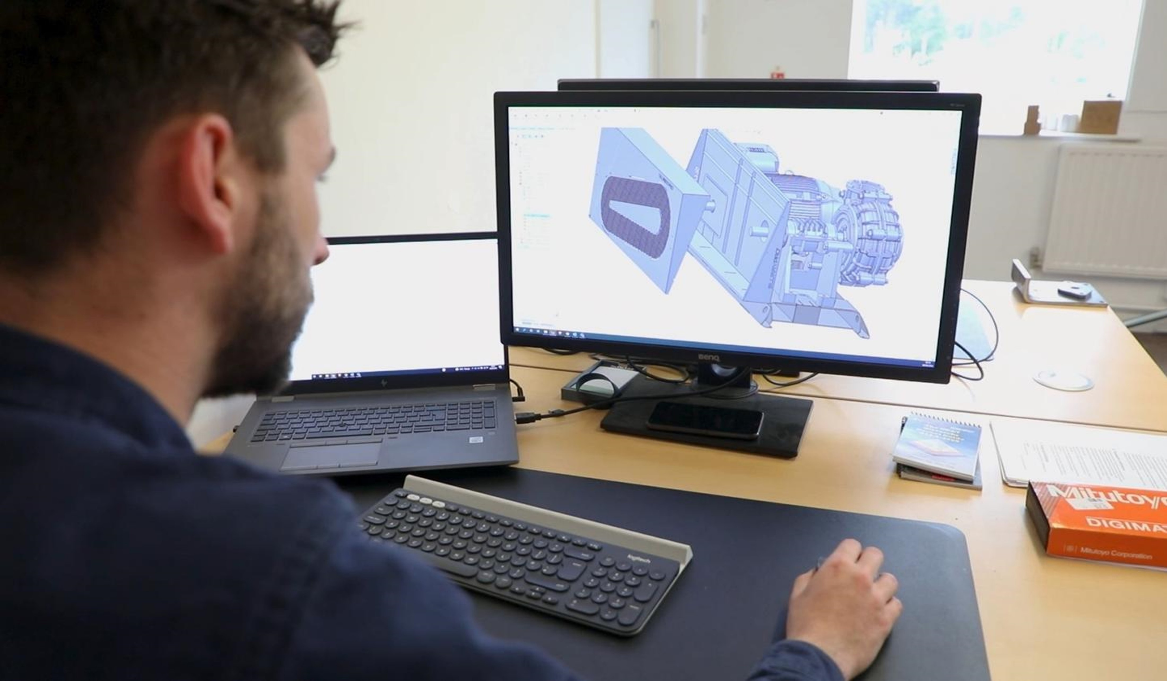

Sustainability
We drive sustainability though efficiency, taking
accountability for the environment, people and the economy.

Slide 18
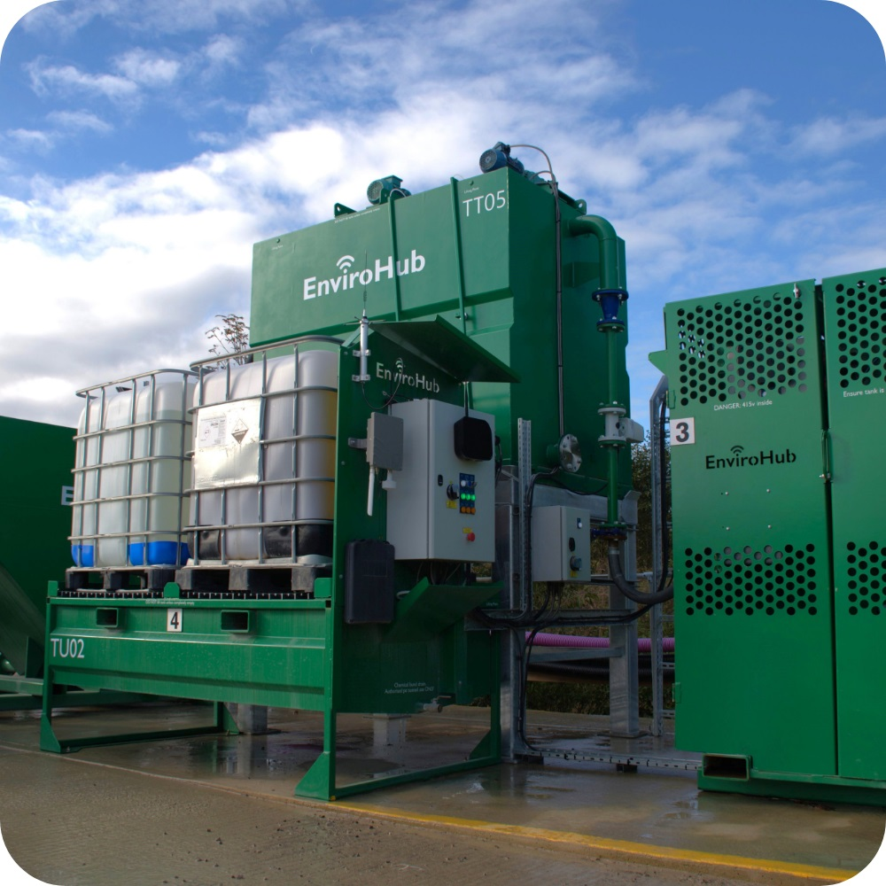
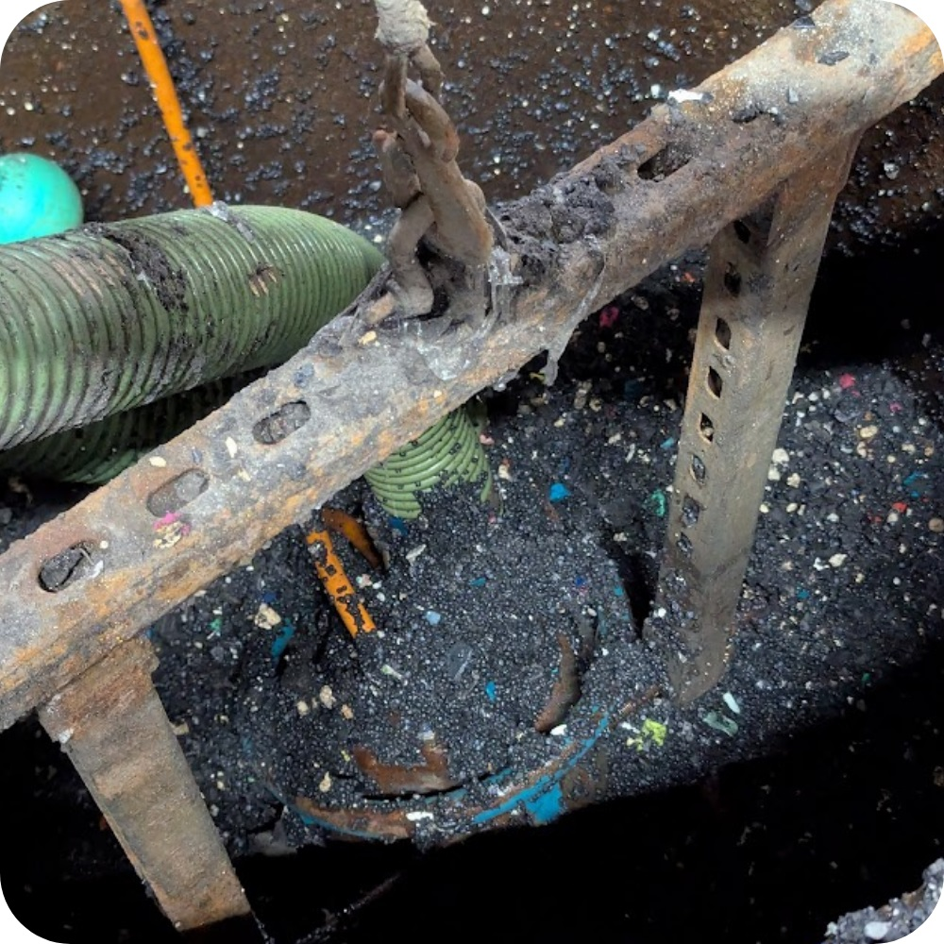

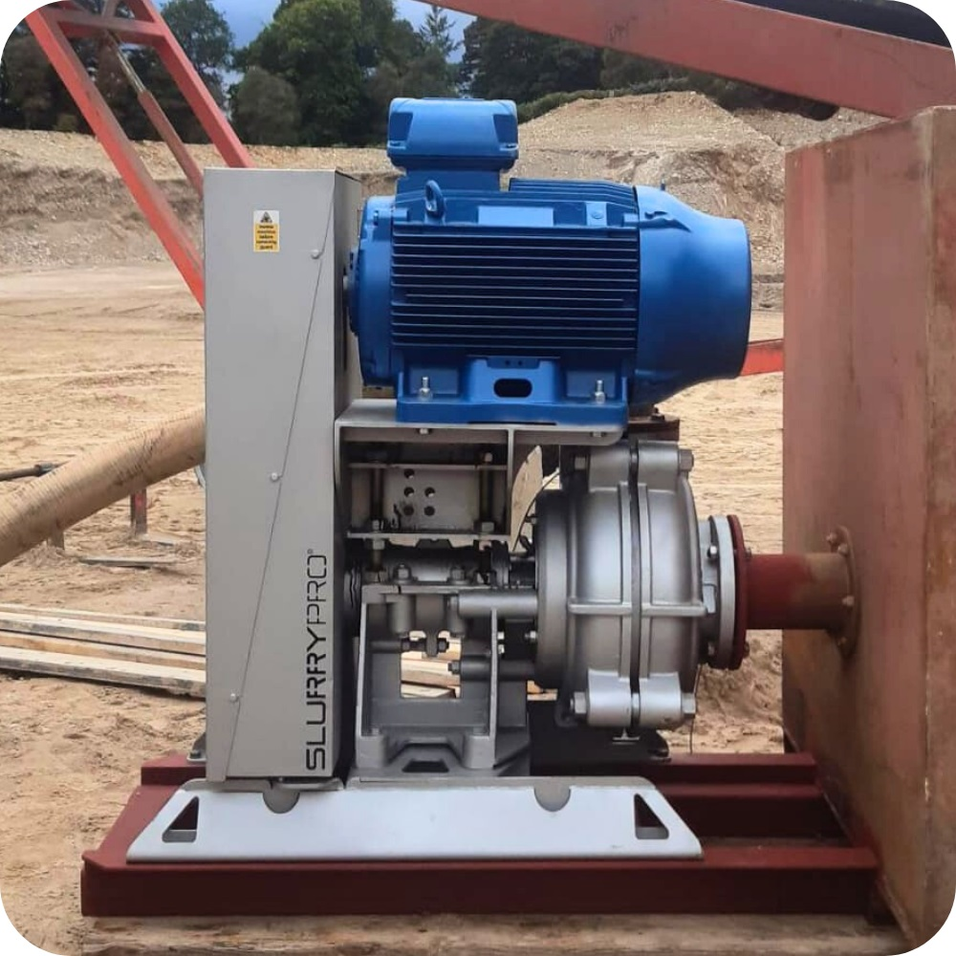
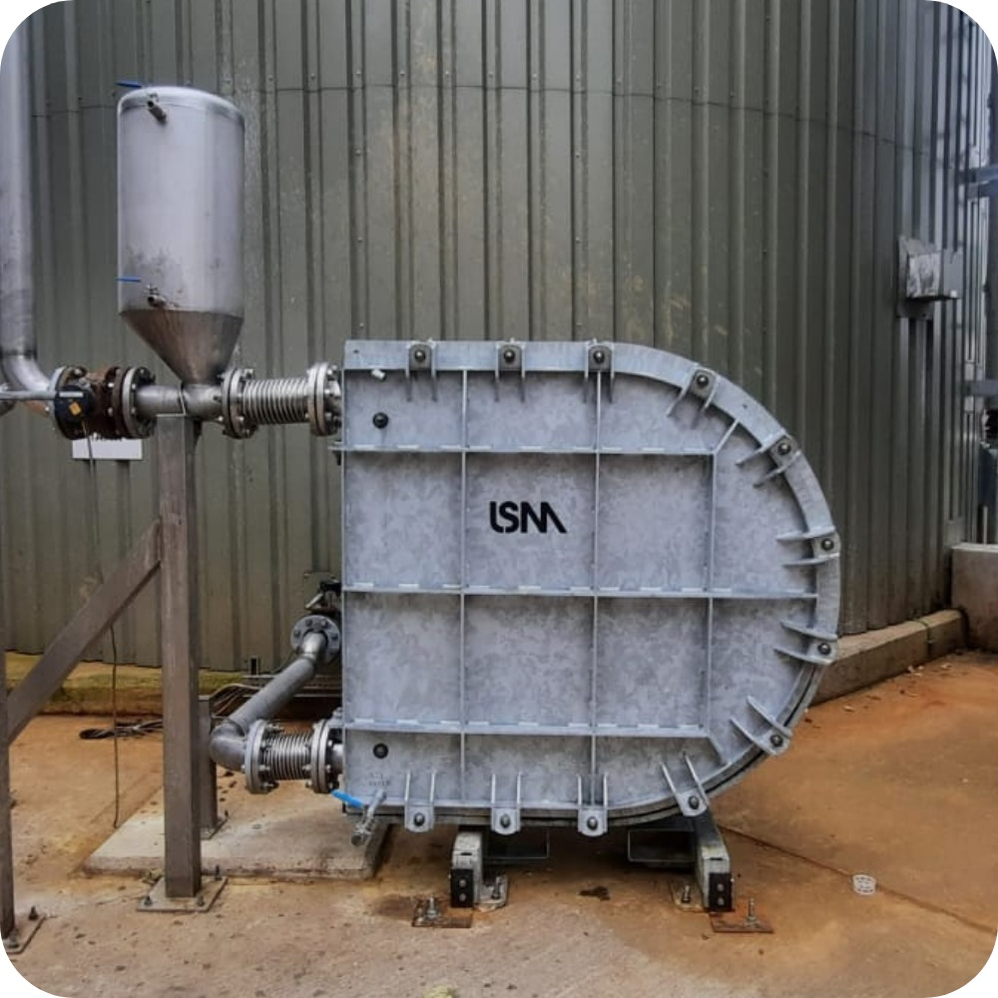
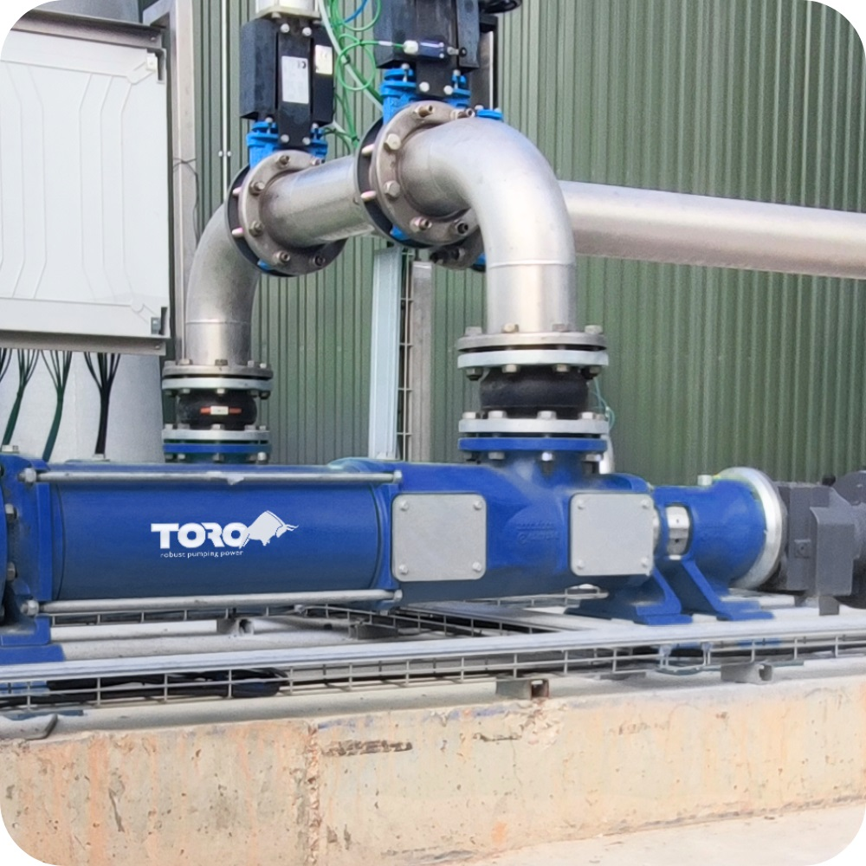
Our
Products
Audex manufacture dewatering pumps for dirty water, mud sludge, and abrasive slurries.
The pumps run fully submerged in sumps, wedge pits or open-water lagoons.

Slide 19

SlurryPro manufacture centrifugal slurry pumps for abrasive slurries.
The range is optimised for longer wear-life, reduced downtime, and lower operating cost.

Slide 20

LSM Pumps manufacture
heavy-duty peristaltic pumps for difficult sludge duties.
High solids, high density, semi-dry, or shear-sensitive – LSM pumps
just keep rolling.

Slide 21

Developed for improved wear-life, energy efficiency, and ease of maintenance, Toro provide a better pump for niche process fluids.

Slide 22

EnviroHub is a modular, water test and treat system for silt, turbidity, pollution removal and pH correction.
EnviroHub is supported by Senteos – a cloud-based answer for monitoring and recording data 24/7.

Slide 23


Meet the Team
Board of Directors
Senior Leadership Team & Leads
Andy Smith
Managing Director
Nathan Rowles
Sales Director
Lee Cass
Operations Manager
Daniel Hughes
Head of Sales
Joseph Ball
Head of Technical
Roger McCreadie
Head of Engineering
Ed Smith
Operations Director
Bill Noakes
Finance Director
Sam Damon
Head of Marketing
Mark McCreadie
Water Lead
Deryck Harmer
Project Lead
Fergus Pridham
Heavy Industry Lead

Slide 24



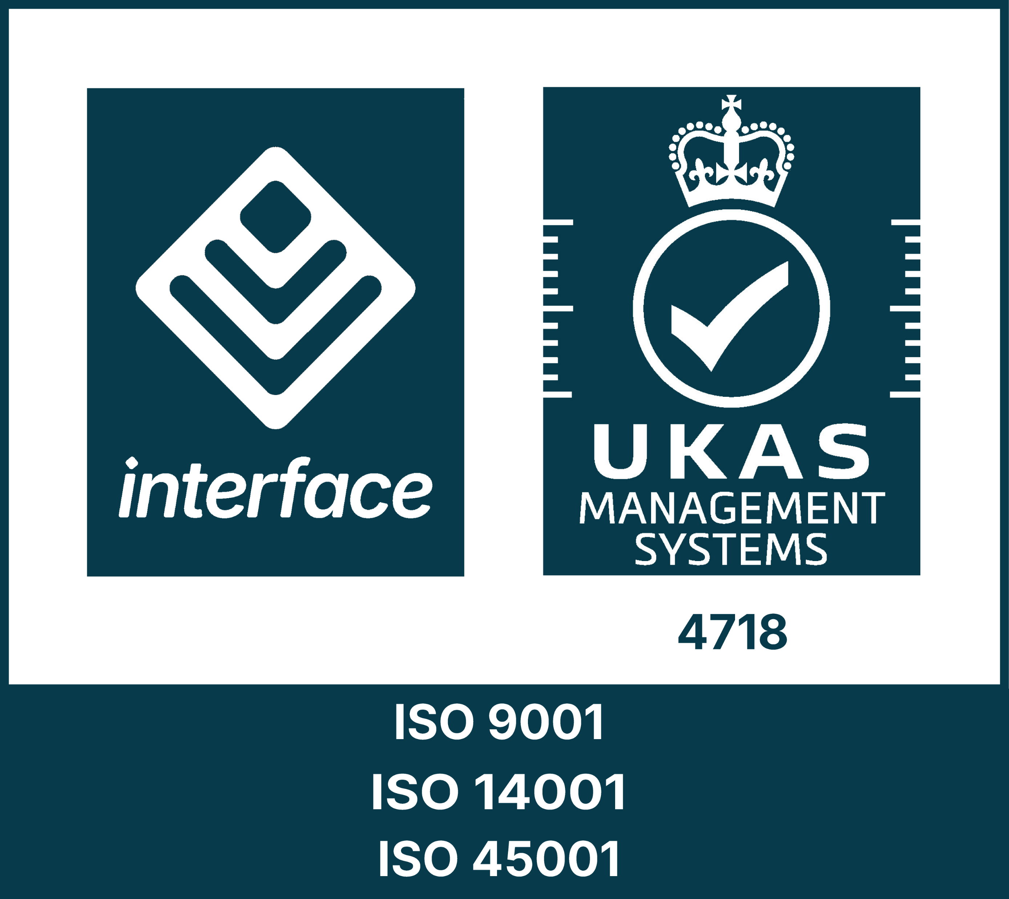





Get in Touch
01246 284 420
07537 149 180 (24/7)
hello@atlantic-pumps.com
atlanticpumps.co.uk
Mon – Fri, 7:30am – 4:30pm

